Slide 1

Learning Based Navigation for Robots
Autonomous Navigation in Random 2D Worlds Using Supervised Learning
August 10, 2025

Slide 2
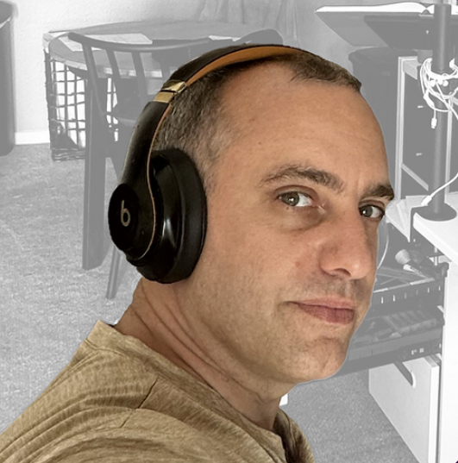


Team Members
Max Boulat
Tanya Neustice
Dylan Scott-Dawkins
AI Wizard
(in training)
AI Wizard
(in training)
AI Wizard
(in training)
Our team is combined in expertise in AI, software, and data science to build and evaluate navigation models, ensuring a robust and collaborative approach.
Replace these placeholder images with your actual photos

Slide 3
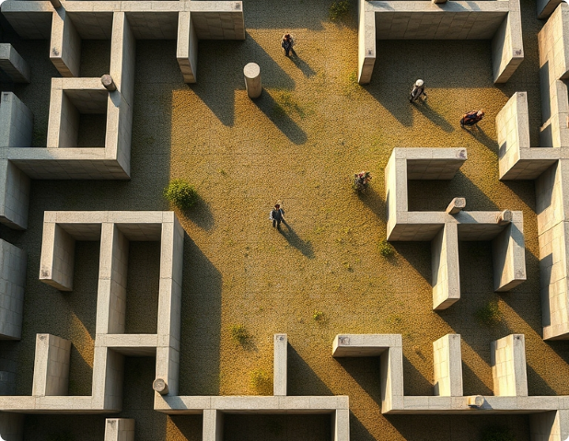
Agenda
Introduction & EDA
Overview of autonomous navigation through complex environments and the challenges in robotics. An exploratory data analysis was done to understand feature distributions and dataset challenges.​
Methodology & Results
Description of the 2D world generator, sensor setup, A* path planning for data labeling, model selection, and results.
Neural Network Results & Interpretation
Neural Networks deep dive, evolving architectures, discussion and future work.

Slide 4


overview
The project investigates autonomous robot navigation in randomly generated 2D worlds filled with obstacles. A world generator creates diverse maps; the robot uses eight radial sensors to perceive its surroundings. Optimal navigation paths are generated by the A* path-planning algorithm, providing expert supervision. Multiple classification algorithms are trained to predict robot actions based on sensor data and goal information. Results show various machine learning models can generalize obstacle avoidance and goal-seeking behavior effectively.

Slide 5
Robots in Random 2D Worlds
01
02
03
Significance of AI Navigation
Challenges in Random 2D Worlds
Project Objectives
AI navigation in uncertain and partially observable environments is critical for many things including autonomous vehicles, exploration, search and rescue, and military uses. Robust algorithms enable robots to safely traverse unknown terrains with obstacles.
Random 2D worlds pose challenges due to partial observability and sensor limits. Robots must interpret noisy local sensor data without full knowledge to make optimal movement decisions.
Develop supervised learning models using A* path-planning data. Define world & sensor models, generate labeled datasets, and evaluate machine learning algorithms for obstacle avoidance and goal-directed movement.

Slide 6
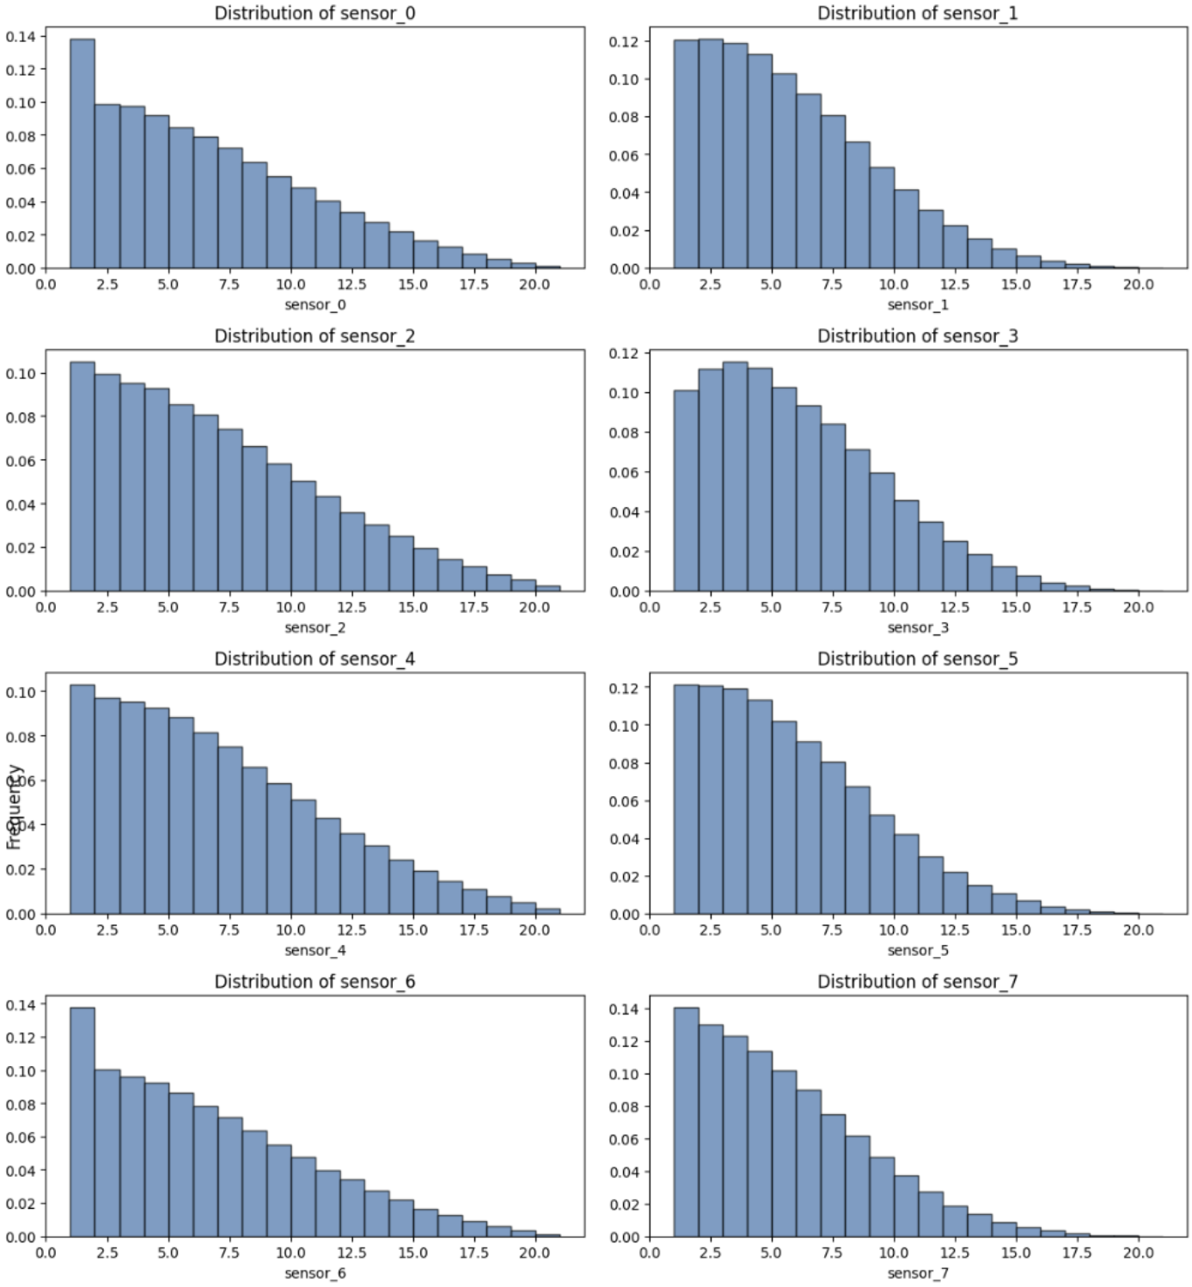
Exploratory Data Analysis
Sensor Data Distribution
All eight sensor readings exhibit right-skewed distributions, indicating frequent smaller distances and fewer long-range detections in the 2D worlds.
This is due to the density of obstacles in its way.

Slide 7
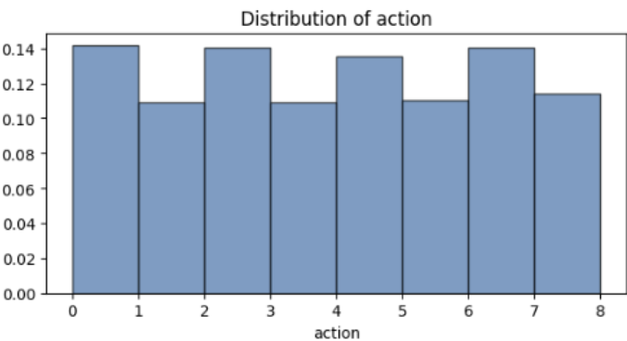
Exploratory Data Analysis
Action Variable Balance
Across all runs, the robot made more lateral and vertical moves (0, 2, 4, 6) than diagonal moves.
The distribution of the agent's chosen actions is well balanced across all eight possible movement directions, ensuring no significant class imbalance during model training.

Slide 8
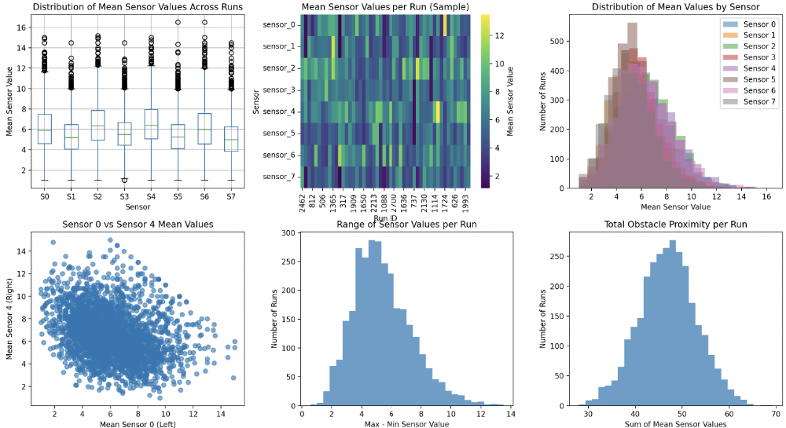
Run Level Variability Analysis
Sensor Distribution Consistency
Mean sensor values across different simulation runs show no significant skew or bias, indicating uniform obstacle placement and environment diversity.
Run-Level Statistical Summary
Summary statistics and distribution plots of sensor readings confirm that each run features distinct yet balanced world configurations, supporting robust model training.

Slide 9
Shifting-Signals Problem
Information Asymmetry
Conflicting Labels
Quantifying Conflicts
Impact on Learning
Identical sensor readings can correspond to different optimal actions because of the random nature of the map and the placement of the start and end goal.
The same local sensor pattern may require different moves depending on the goal location, leading to conflicting labels for identical inputs in the training data.
Through data measurment 31.7% of sensor patterns had conflicting action labels. That number was reduced to 8.8% when goal direction was included as a feature.
Conflicting labels create ambiguity for supervised models, limiting their ability to generalize and forcing reliance on additional spatial features like goal direction.

Slide 10
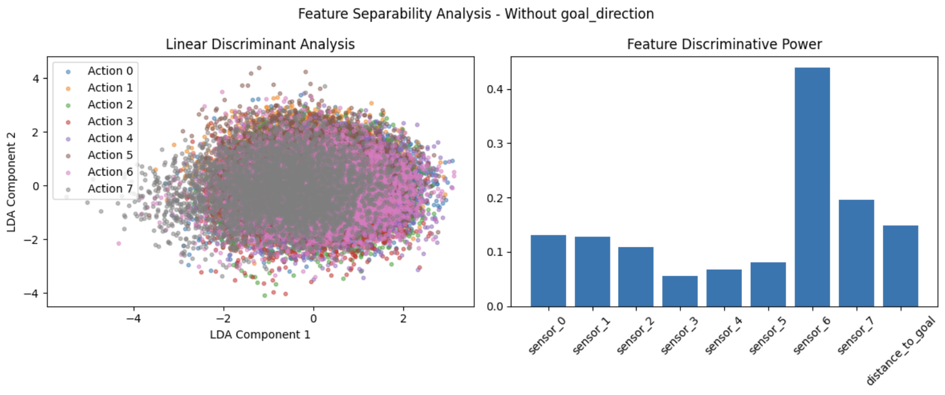
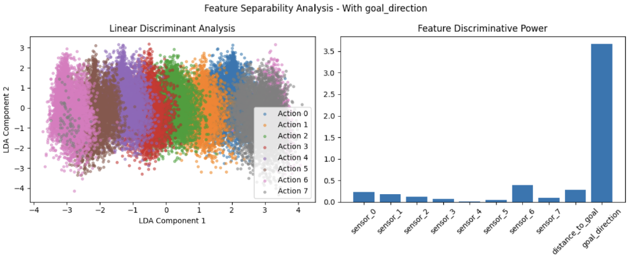
Feature Uniqueness Analysis
01
The model struggled to differentiate actions due to conflicting labels for identical sensor inputs.
There is no clear variable to use as the deciding factor.
Without Goal Direction
02
Adding the goal direction feature clarifies action discrimination, making the goal direction the dominant factor and significantly reducing label conflicts for identical sensor states.
With Goal Direction

Slide 11
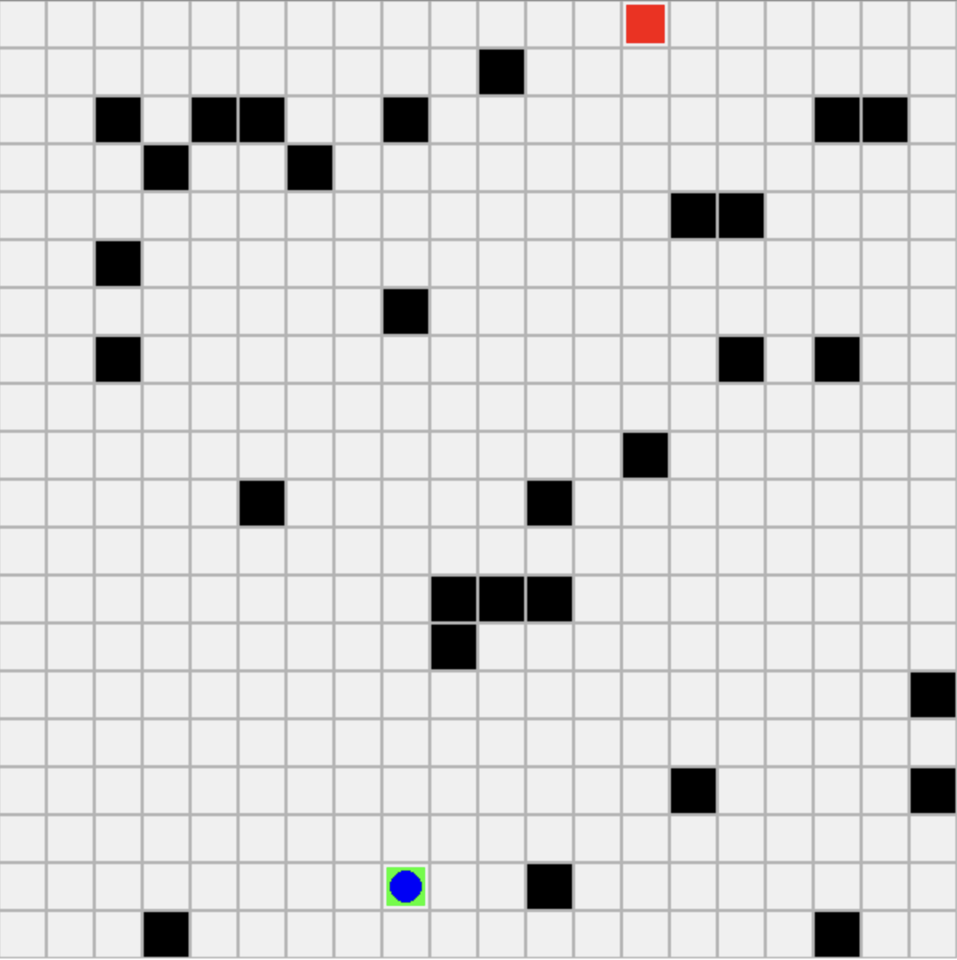
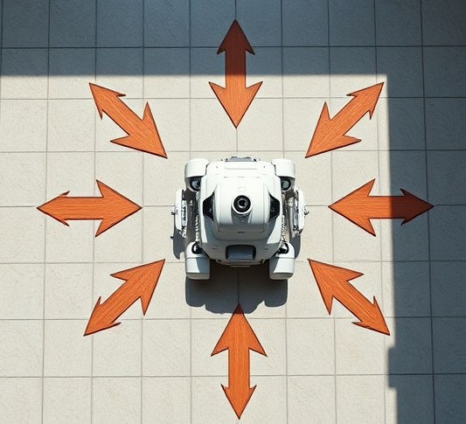
World Generation and Sensors
Methodology
2D World and Obstacles
The environment is a 20×20 grid populated randomly with single-cell obstacles and linear walls, ensuring diverse layouts for each simulation run. Start and goal points are chosen with a minimum distance and are free of obstacles.
Sensor Setup and State Features
The agent has eight radial distance sensors measuring empty tiles to obstacles in eight directions. Additional features include Euclidean distance and angular direction to the goal, forming the input for supervised learning models.

Slide 12
Data Generation Using A* Algorithm
Methodology
01
02
03
04
05
A* Search Algorithm
Path Generation
Data Recording
Dataset Schema
Supervised Learning Dataset
A* uses a priority queue to explore nodes with the lowest estimated total cost, combining path cost and heuristic (Euclidean distance to goal) to find optimal paths efficiently.
For each randomly generated 20×20 world, A* computes the optimal path from the start to the goal, considering obstacles and walls to ensure collision-free navigation.
At every step along the path, data recorded includes timestamp, run identifier, agent position, eight radial sensor distances, Euclidean distance to goal, goal direction, and the A*-selected action.
Key variables include sensor_0 to sensor_7 (distances to nearest obstacles), distance_to_goal, goal_direction (angle to goal), and action (integer 0–7 indicating movement direction).
The collected data forms a labeled dataset where sensor readings and positional features serve as input features, and the A* optimal moves serve as target labels for training classification models.

Slide 13
Dataset Variations
Data
goal_dist_3k
Contains 3,000 runs with 35,452 labelled instances using only sensor readings and distance to goal, without goal direction.
goal_dist+goal_dir_3k
Same sample size but adds goal direction feature, improving spatial awareness and model performance.
goal_dist+goal_dir_10k
Largest dataset with 10,000 runs and 118,211 labelled instances including goal direction.
goal_dist+goal_dir_3walls_10k
Largest dataset with 10,000 runs and 118,211 labelled instances including goal direction and added complexity of three walls for obstacle navigation.

Slide 14

Evaluation Metrics
Evaluation
Accuracy as Primary Metric
Accuracy measures the percentage of correct action predictions by the model on test data, providing a straightforward indicator of performance given the balanced action classes.
Balanced Classes Importance
Balanced distribution of navigation actions ensures accuracy is a reliable metric without bias toward any specific movement direction.
Simulation for Validation
Simulation environments test models on new randomly generated 2D worlds, enabling us to visually inspect their behavior as they work their way through the world.

Slide 15
Model Selection Overview
Model Training
Random Forest
XGBoost
Logistic Regression
Support Vector Machine (SVM)
Naïve Bayes, KNN & Neural Network
An ensemble method that handles non-linear feature interactions well and provides stable performance without extensive preprocessing.
A powerful gradient boosting algorithm known for superior performance on structured data, capable of calibrated class probabilities.
A simple, interpretable linear model used as a baseline for multi-class classification with multinomial output.
Utilizes RBF kernel to model smooth yet non-linear decision boundaries, suitable for complex class separations.
Naïve Bayes offers simplicity but strong independence assumptions; KNN excels at local structure learning; Neural Network (MLP) captures complex non-linear patterns with multiple hidden layers.

Slide 16
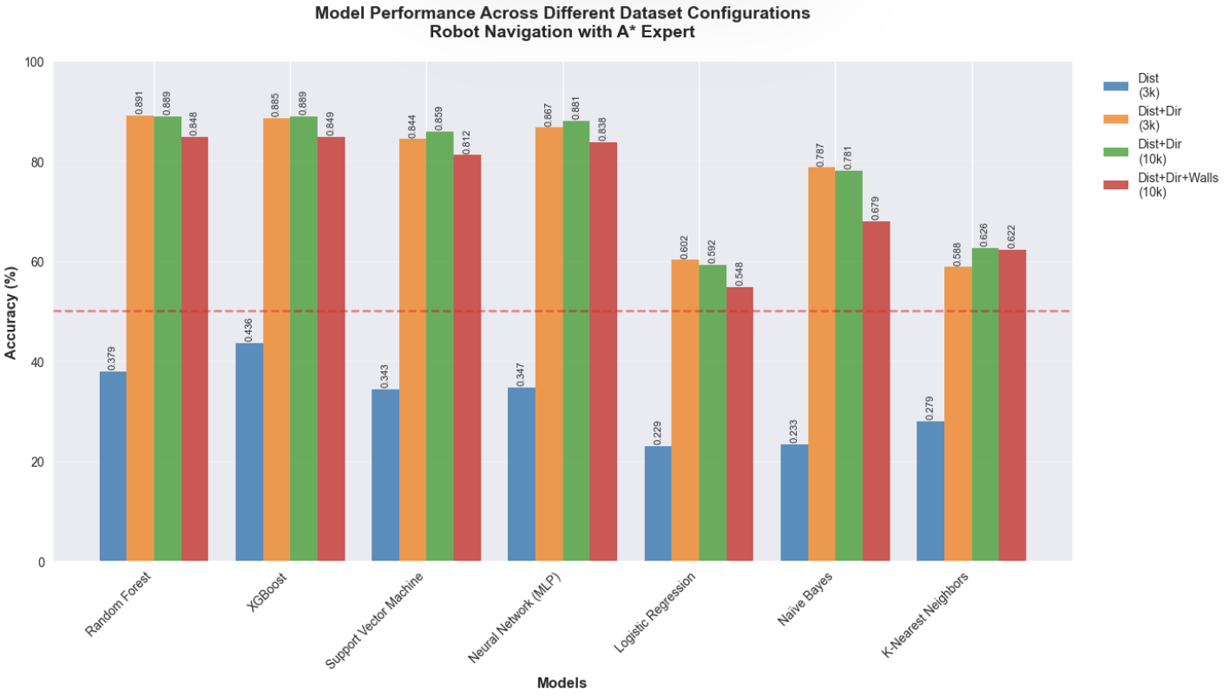
Results
Results
goal_dist_3k
Models perform modestly with only goal distance; Random Forest and XGBoost lead with 37.9% and 43.6% accuracy.
goal_dist+goal_dir_3k
Adding goal direction boosts accuracy significantly; Random Forest hits 89.1%, XGBoost 88.5%, showing directional features' importance.
goal_dist+goal_dir_10k
Increasing the dataset size from 3 to 10k did not make a big difference.
goal_dist+goal_dir_3walls_10k
Adding walls reduces accuracy slightly; Random Forest and XGBoost remain strong near 85%, while simpler models drop more.

Slide 17
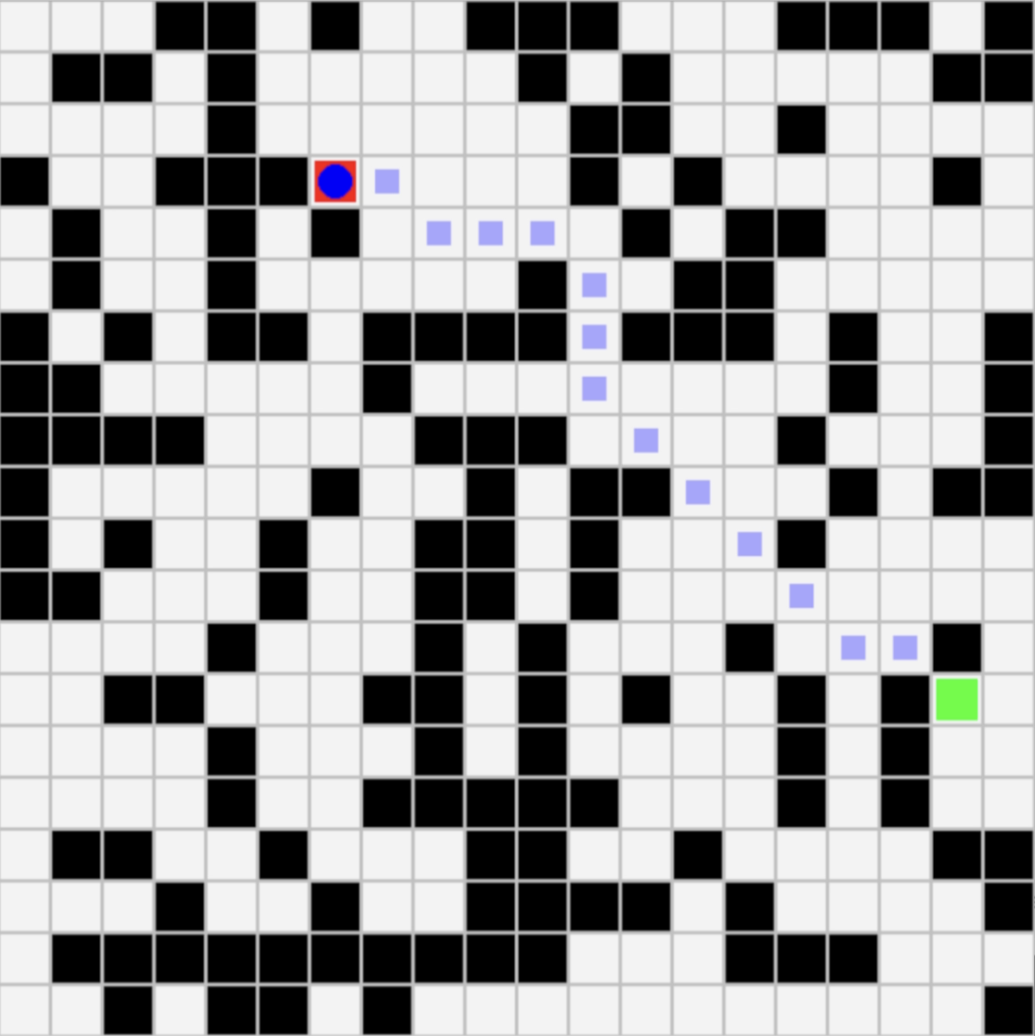
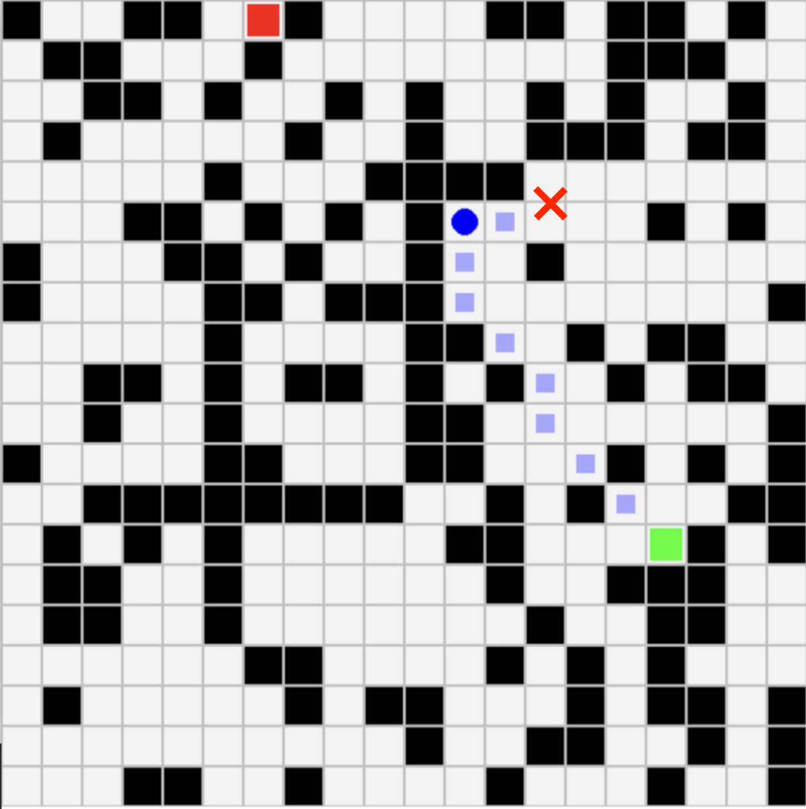
Performance in the simulator
Results
Successful Pathfinding
Trained models demonstrate good pathfinding and obstacle avoidance behavior when faced with new random worlds as long as the path to the goal does not involve major deviations.
This shows that their good accuracy scores are not due to overfitting on the training data but of guenuine generalization of A* style spatial reasoning.
Inability to overcome more complex scenarios
Model performance breaks down when finding the path to the goal involves circumventing a major obstacle or backing out of a dead-end. Their ability to plan beyond simple obstacle avoidance is poor.

Slide 18

Demo

Slide 19
Neural Network Architecture Choices
Architecture Design Considerations
We experimented with fully connected multi-layer perceptrons (MLPs), tuning layer count, units per layer, activation functions and initial choice of y^{hat}. Proper architecture is critical to learn complex sensor-to-action mappings while avoiding overfitting and underfitting.
Performance of Various Architectures
Two-layer MLPs with moderate widths (e.g., [64, 32]) outperformed deeper 3-layer networks and wider layers, achieving the highest accuracy (~0.846).
Output Layer and Training
Using a softmax output layer with cross-entropy loss for classification targets enabled stable training. Linear outputs were tested for continuous directions but classification with softmax proved more effective for discrete navigation actions.

Slide 20
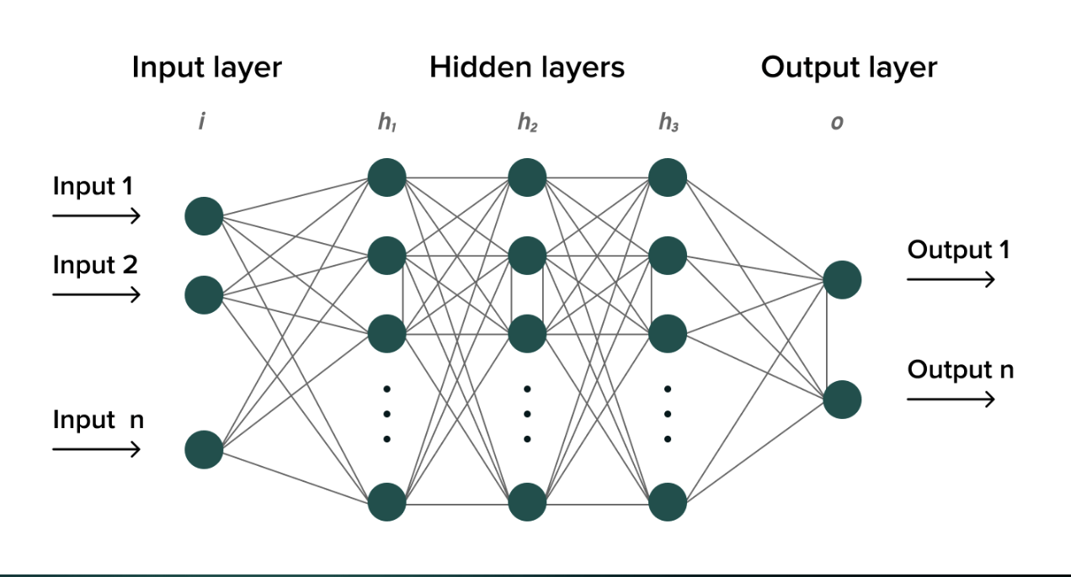
Neural Network Architecture
A neural network is a black box in that input (8 sensors) goes into it and results (one of 8 directions) comes out.
Difficult to reason about internally.
Internally performs repeated linear transforms followed by non-linear transforms.
Feedforward NNs are used in Large Language Models, making them particularly interesting.

Slide 21
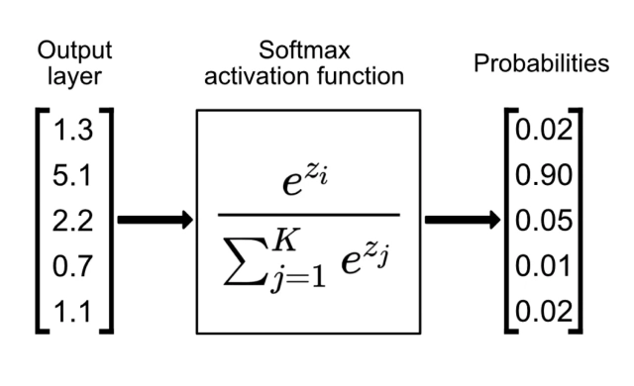
Neural Network Variants
Two versions: First version
Predict Y^{hat} = action (0..8)
Categorical output layer of 8 nodes: Uses softmax for one of 8 directions
The output will be the action (up,down,left etc) closest to the highest entry of the vector.
Idea here is to follow the optimal training action as close as possible

Slide 22
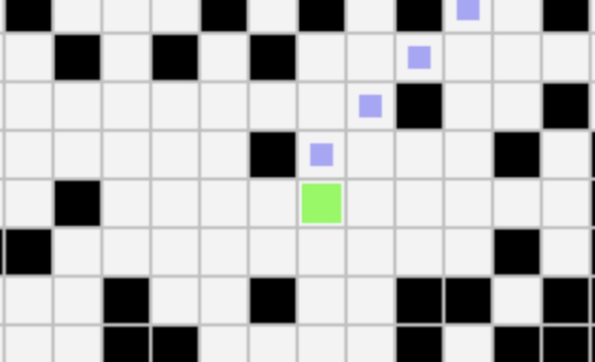
Neural Network Variants
Two versions: Second Version
Predict Y^{hat} = direction to goal
Continuous output layer consisting of on single float indicating next direction to follow
Due to time constraints we decided to push the full development of this idea to future work. Our hypothesis here is that the network can more easily perform back-propagation using a single continuous output node…
Notes:
Citation of: https://www.singlestore.com/blog/a-guide-to-softmax-activation-function/

Slide 23
Neural Network Architecture Evolution
DEAP (Distributed Evolutionary Algorithms in Python) used to search architecture space
Individuals represent MLP layer configurations (e.g., [64, 32], [128, 64, 32])
Fitness function: Validation accuracy over training set
Discovered top 2-layer architecture [64, 32] with 0.846 accuracy
Evolution avoided manual trial-and-error and explored a wide range of architectures
Due to our code refactor we could not incorporate DEAP directly into the framework due to the validation loop being separate from the training loop. We therefore run the same manual neural network architectures through our frameworks and recorded the accuracy results repeated here on the next slide:

Slide 24
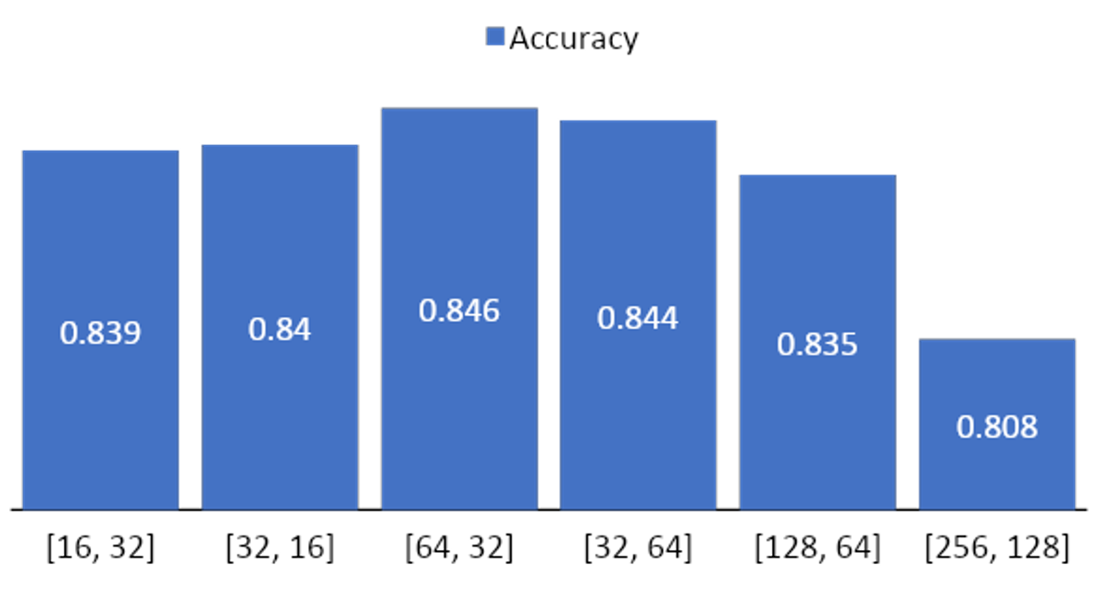
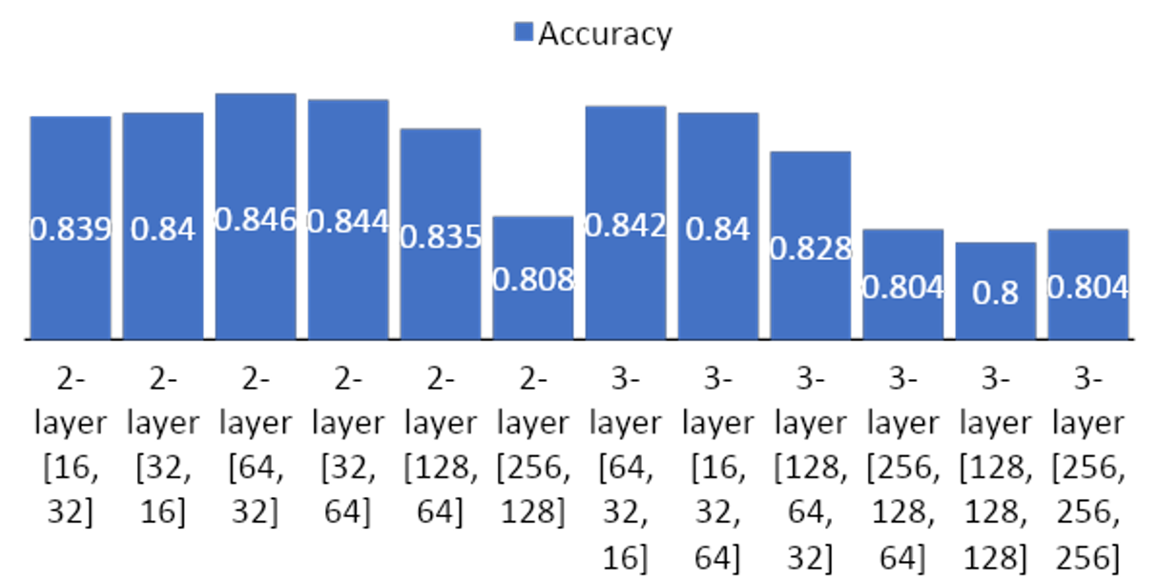
Neural Network Architecture Results
Accuracy of 2-layer MLP Architectures
Accuracy of 3-layer MLP Architectures
The [64, 32] setup balances capacity & generalization, achieving 0.846 accuracy. Smaller or asymmetrical layers perform slightly worse.
3-layer MLPs tend to overfit and have lower accuracy. The funnel-shaped [64, 32, 16] is best among 3-layer but below top 2-layer.

Slide 25




Discussion: Model Performance Insights
Impact of Feature Design
Model Robustness
Including goal direction and distance features significantly reduces label ambiguity and improves action prediction accuracy across all models, highlighting the importance of rich spatial information. Imagine an agent in a maze without any information about where to go in general.
Random Forest and XGBoost consistently deliver high accuracy and interpretability, demonstrating strong generalization to novel environments and effective obstacle avoidance within sensor limits.
Limitations in Obstacle Avoidance
Future Improvement Opportunities
All models struggle with complex navigation around large or multiple walls, especially when paths require deviating several tiles from the direct goal direction due to limited local sensing. Introducing walls saw a performance drop of approx 5% across the best performing models.
Advancing sensor capabilities, incorporating temporal memory, and exploring reinforcement learning could enhance decision-making, helping models overcome partial observability and complex planning challenges.

Slide 26
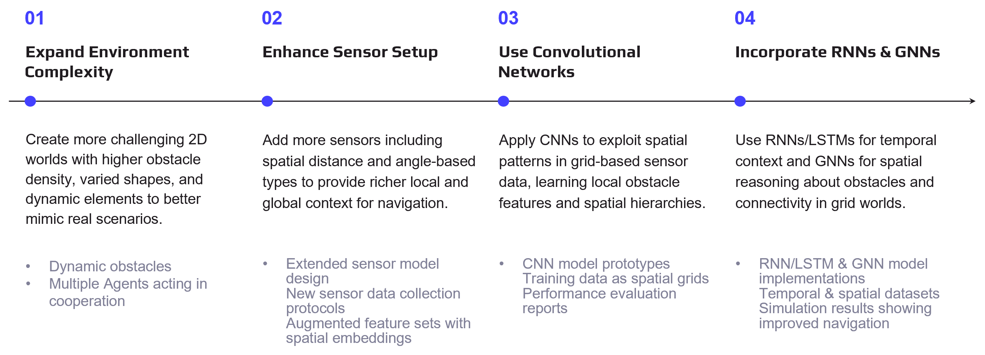

Future Work: Increasing Environment Complexity

Slide 27
Future Work: Advanced Learning Paradigms
Reinforcement Learning
Improved Imitation Learning
Hierarchical Planning
Temporal & Spatial Reasoning
Use RL methods like DQN and PPO to train agents via rewards, enabling navigation without expert data. Implemented Q learning however: computationally challenging.
Apply algorithms like DAgger to reduce errors by incorporating expert feedback on the agent’s own paths.
Use multi-level planning to break down tasks into goal selection and control, improving complex decision-making.
Combine RNNs, LSTMs, and GNNs to maintain memory and understand spatial topology for better navigation.
Adaptive navigation policies Robust obstacle avoidance Handling noisy environments
Reduced error accumulation Better generalization Expert-guided policy refinement
Multi-level decision frameworks Long-horizon planning Scalable navigation strategies
Temporal context awareness Spatial structure understanding Improved partial observability handling

Slide 28

Conclusion
Incorporating spatial features like goal direction and distance greatly improves supervised learning model accuracy for robot navigation in random 2D worlds. Ensemble models such as Random Forest and XGBoost showed the highest accuracy and robustness. However, all models struggled with larger obstacles due to limited local sensor data and partial observability. This highlights the need for richer sensors and advanced architectures with temporal reasoning and planning capabilities. Future work should explore memory-based networks, reinforcement learning, and enhanced sensors to enable more reliable autonomous navigation.

Slide 29
The End. Thank you for watching!

